Slide 1

Goodness of Gradle
Syamala Myneni

Slide 2


Slide 3
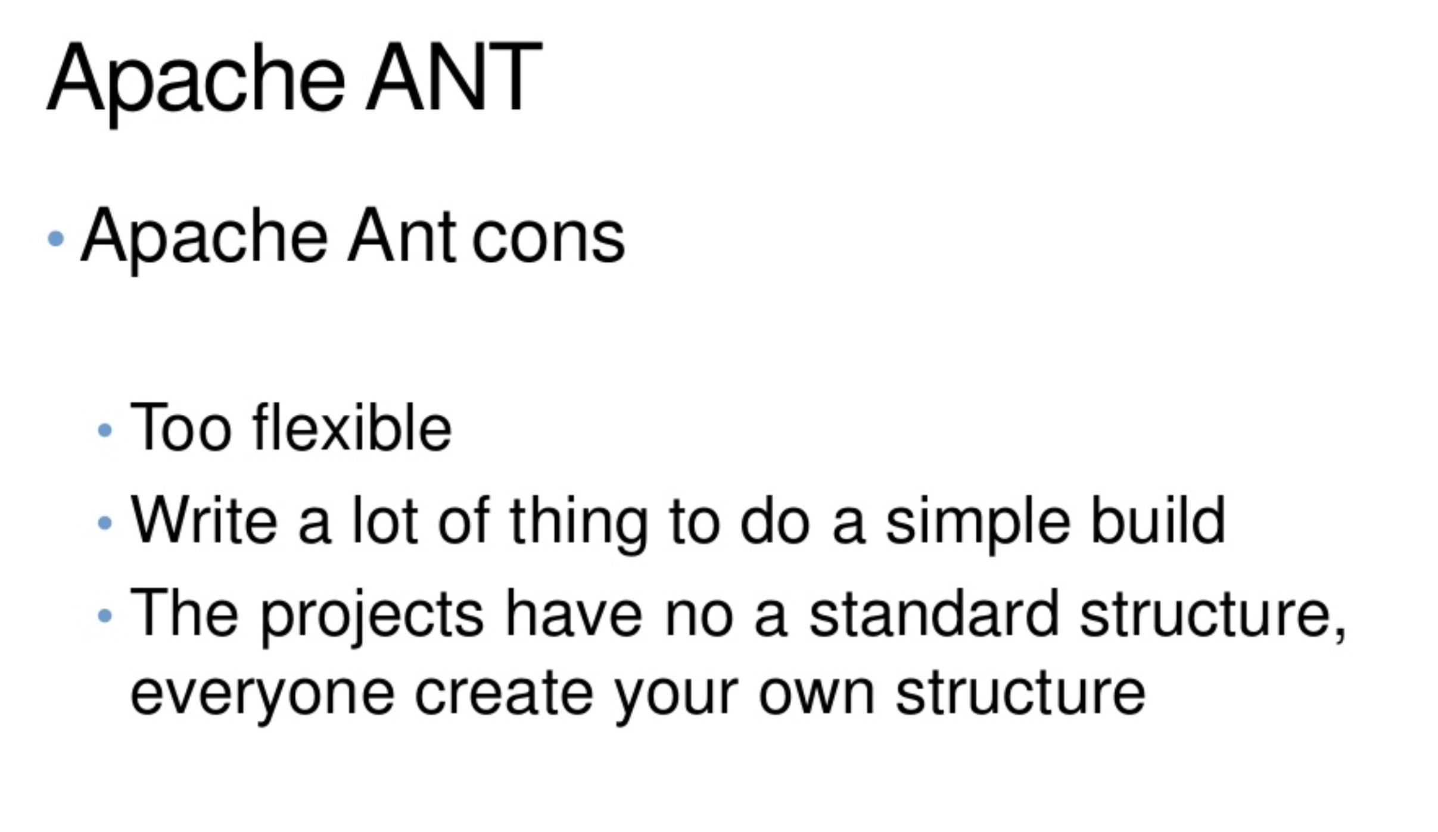

Slide 4
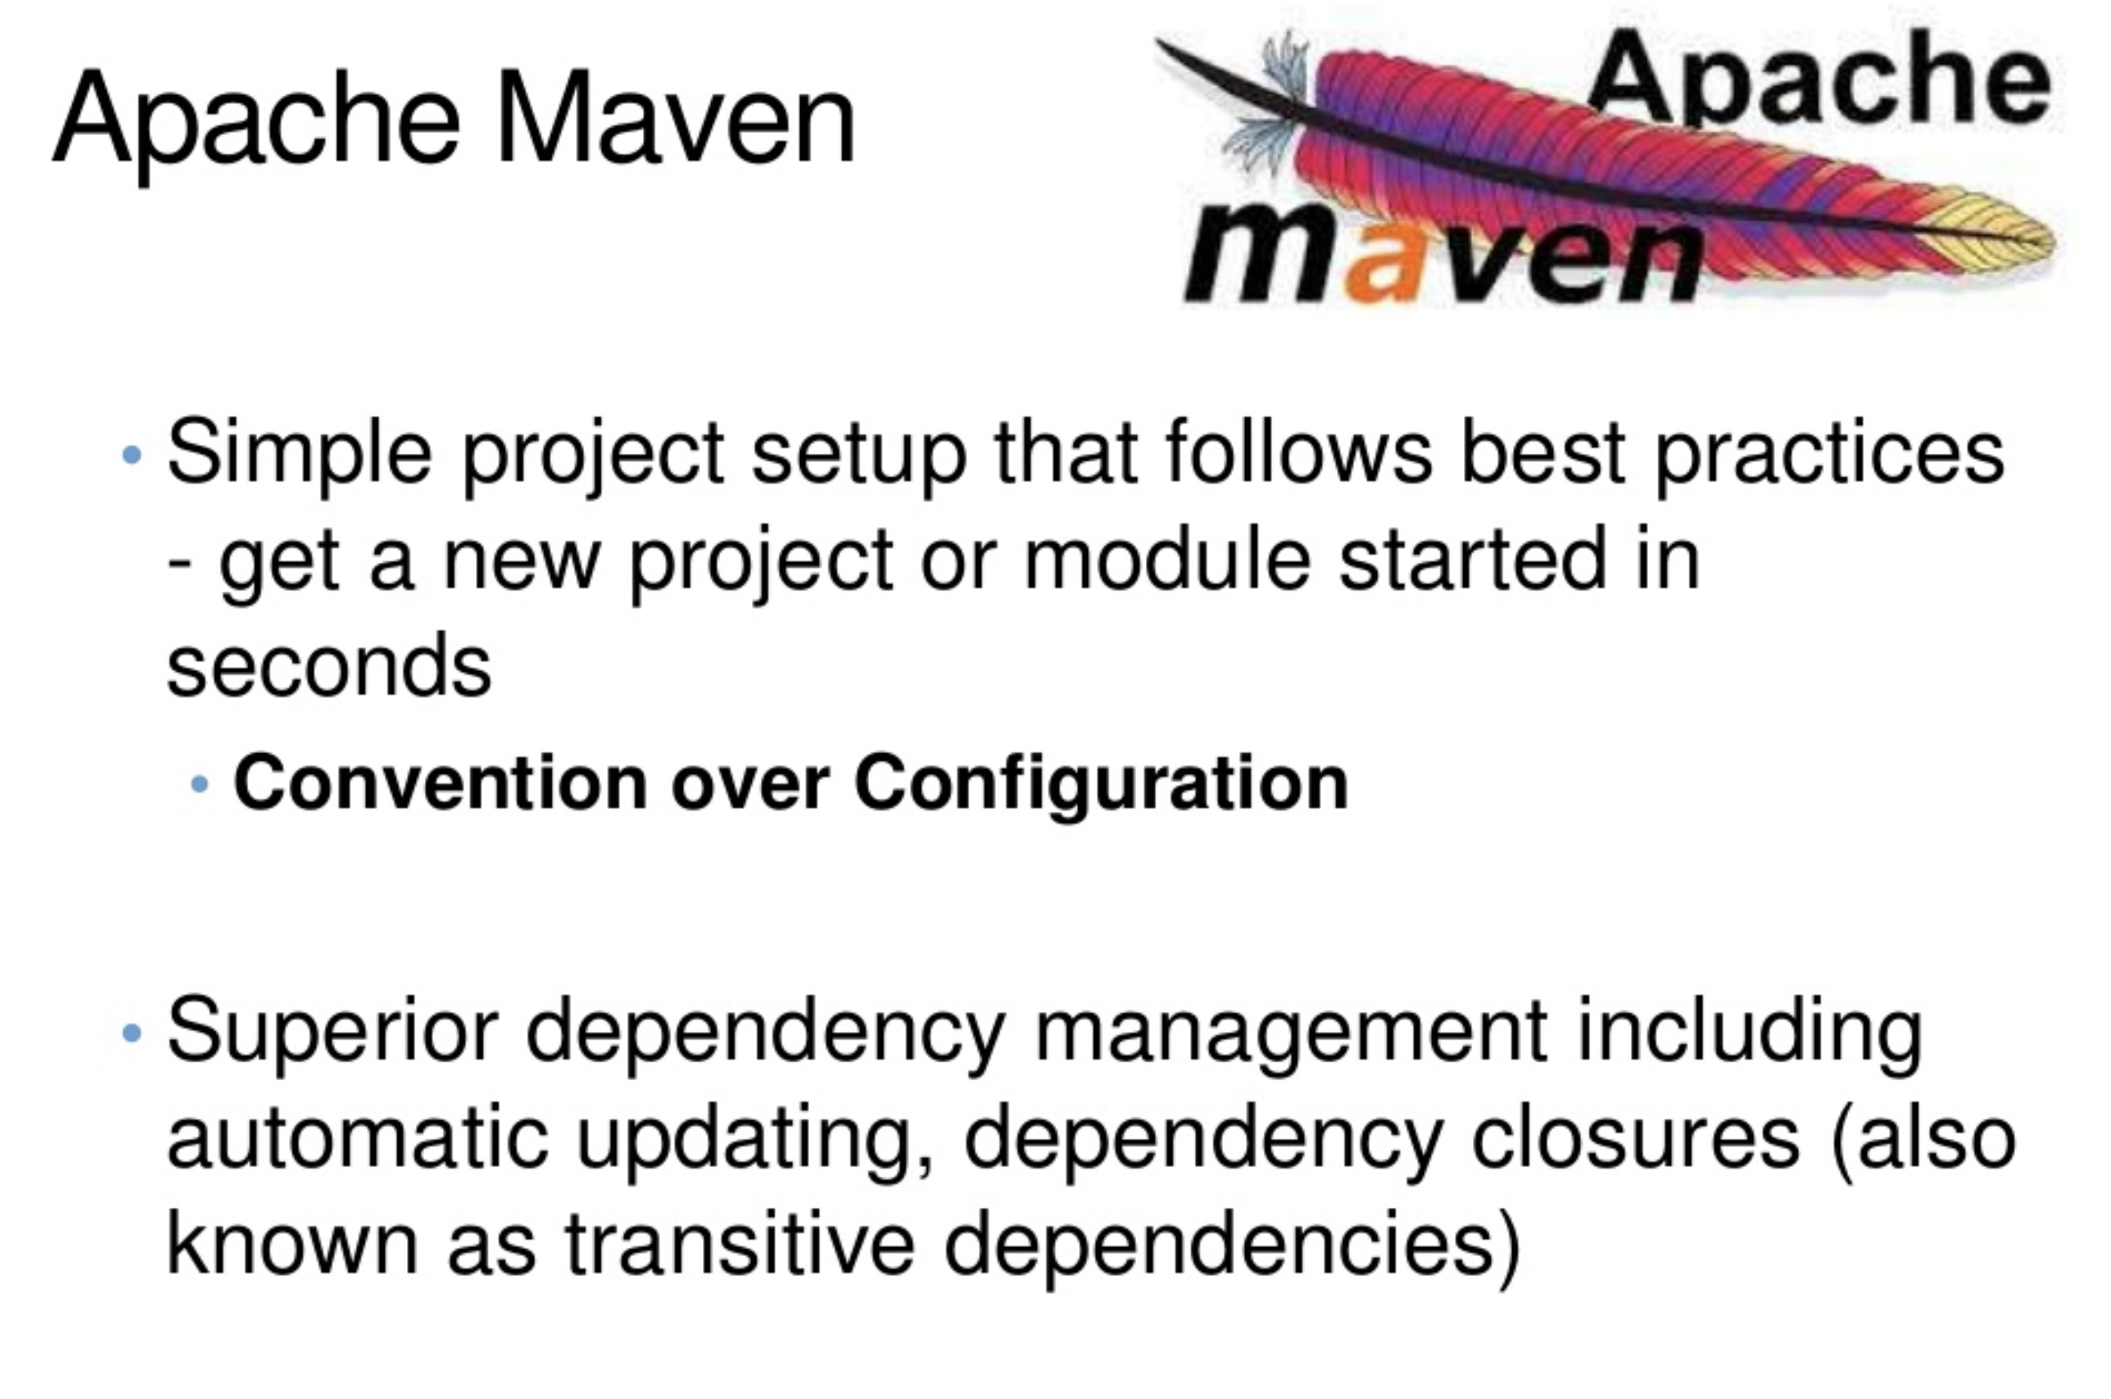

Slide 5
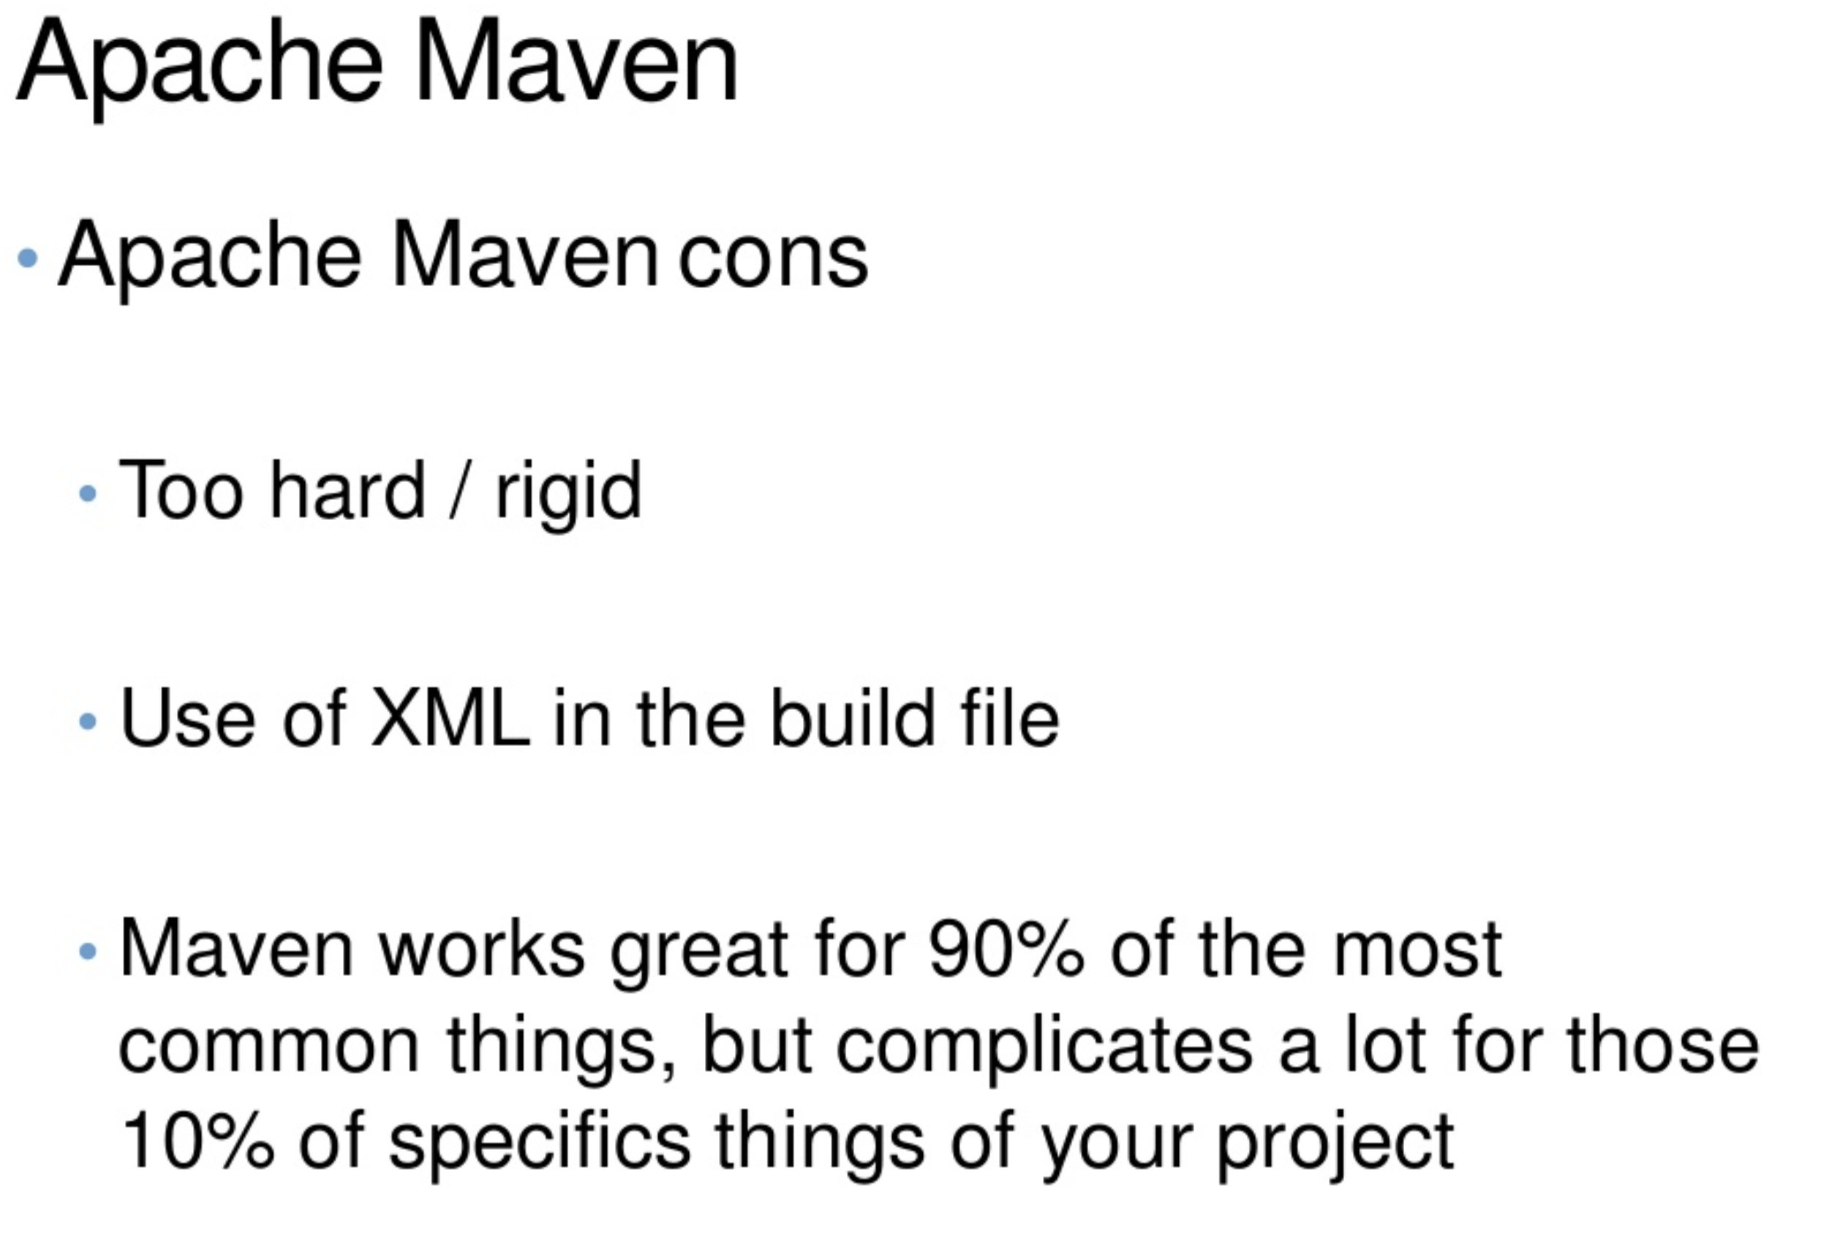

Slide 6
Gradle
Gradle is an open-source build system using a Groovy DSL (Domain specification language) syntax as a succinct alternative to the XML of Ant or Maven.

Slide 7
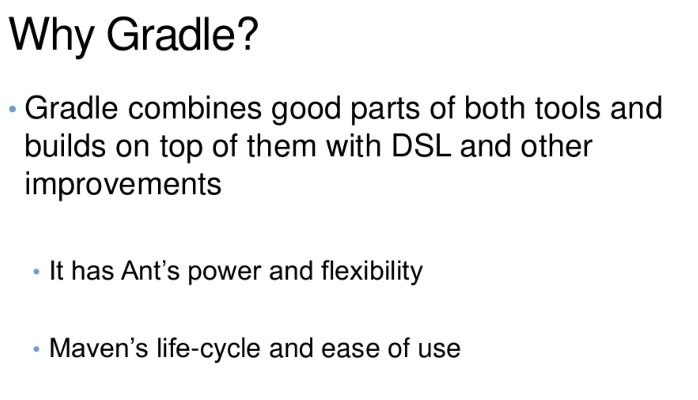

Slide 8
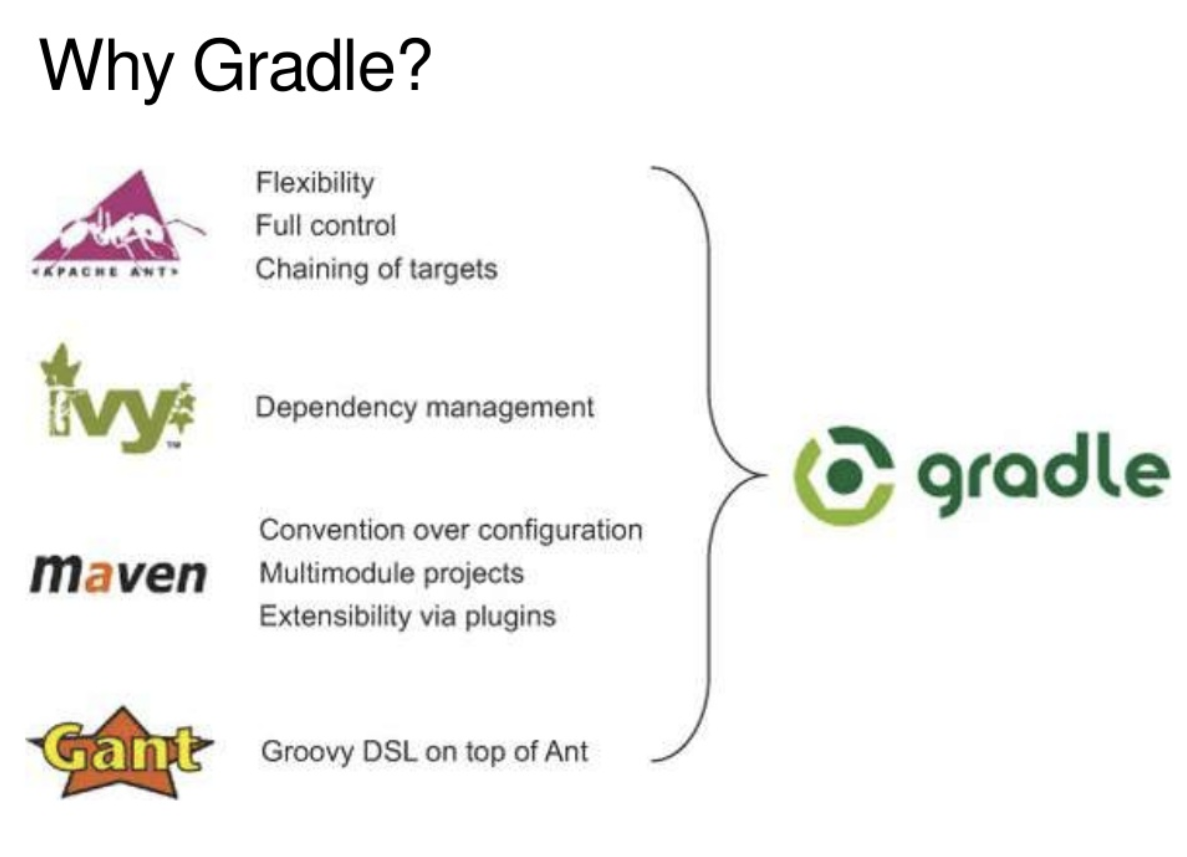

Slide 9
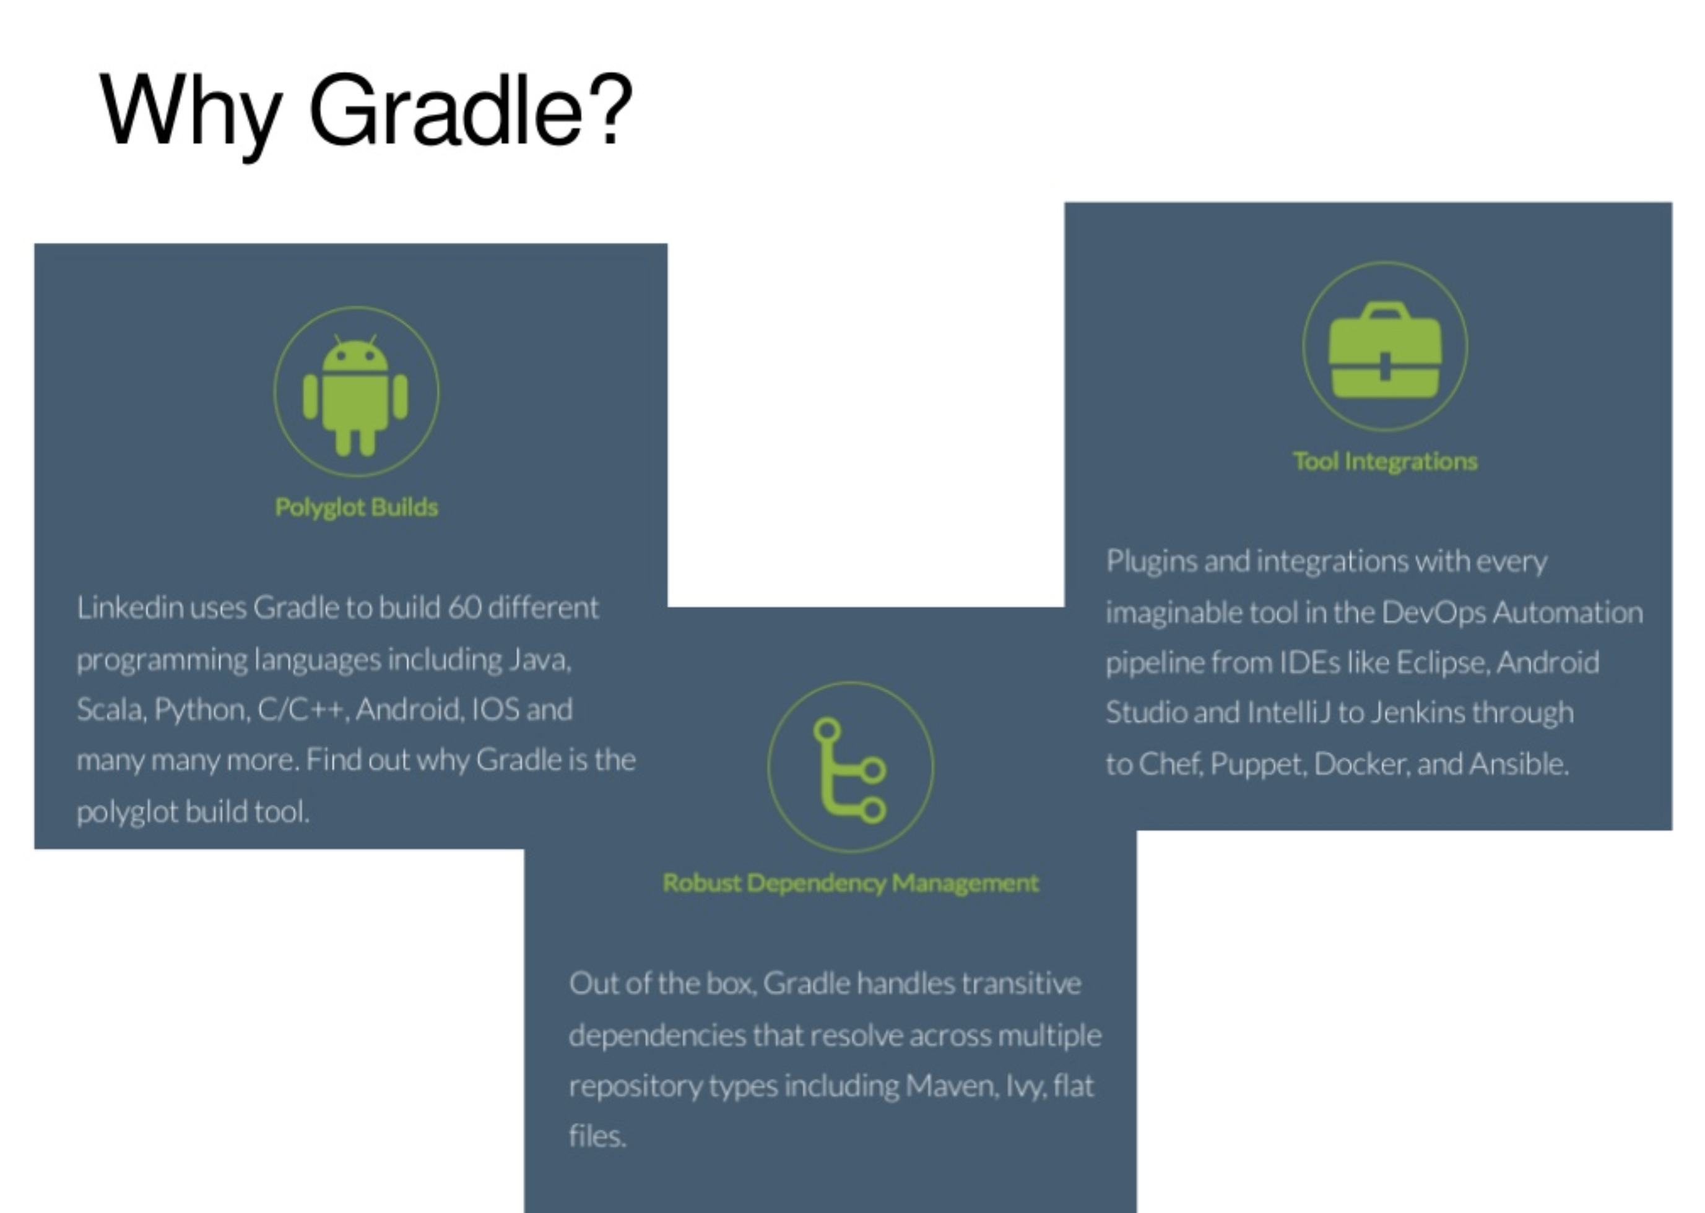

Slide 10
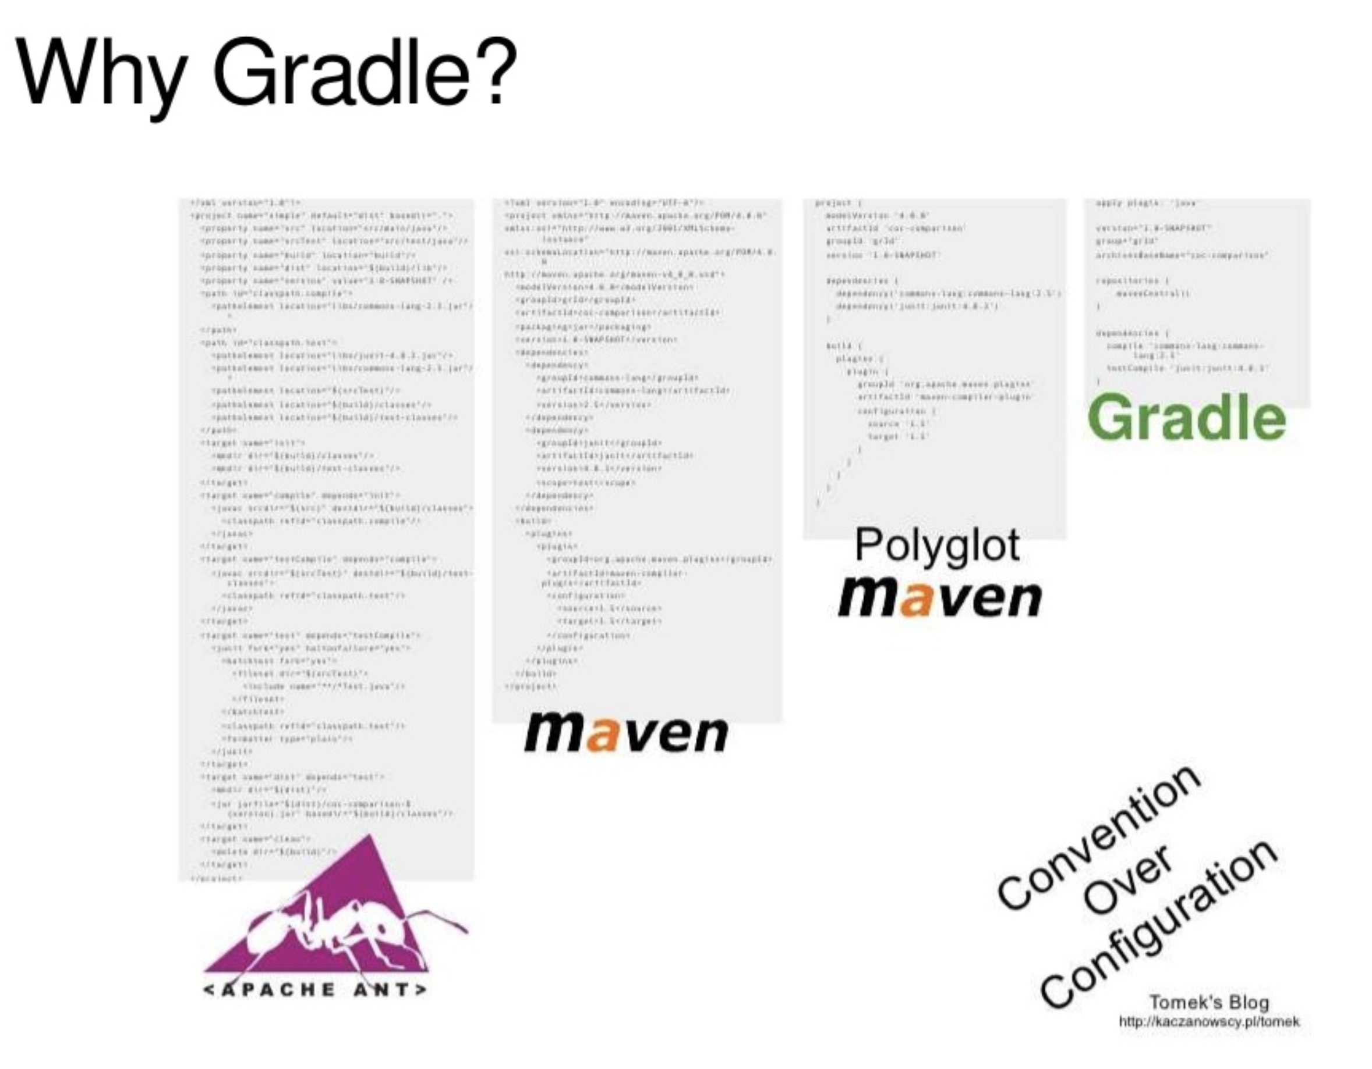

Slide 11
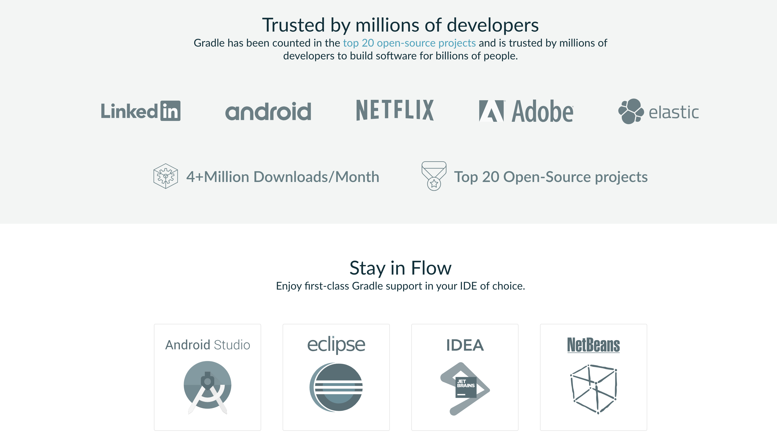

Slide 12
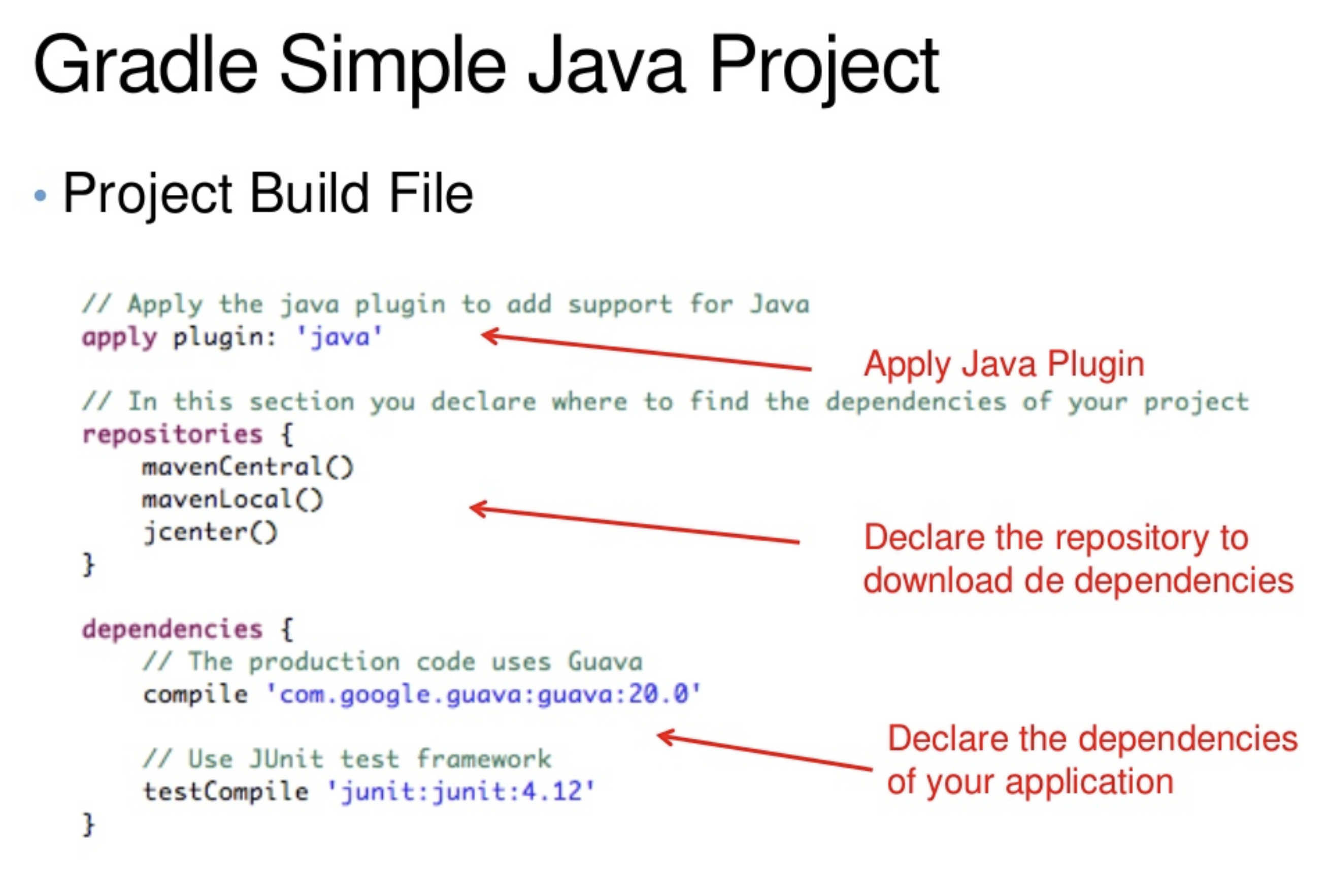

Slide 13
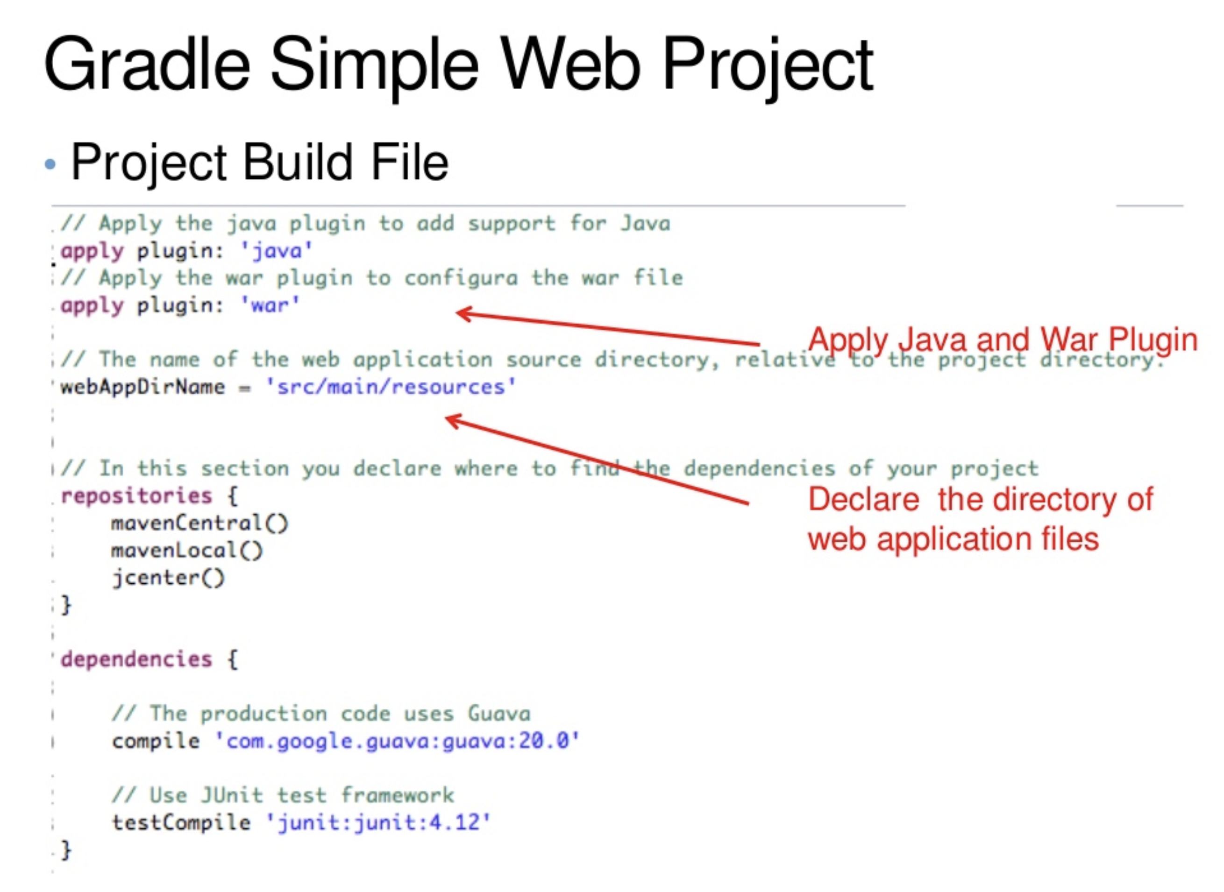

Slide 14
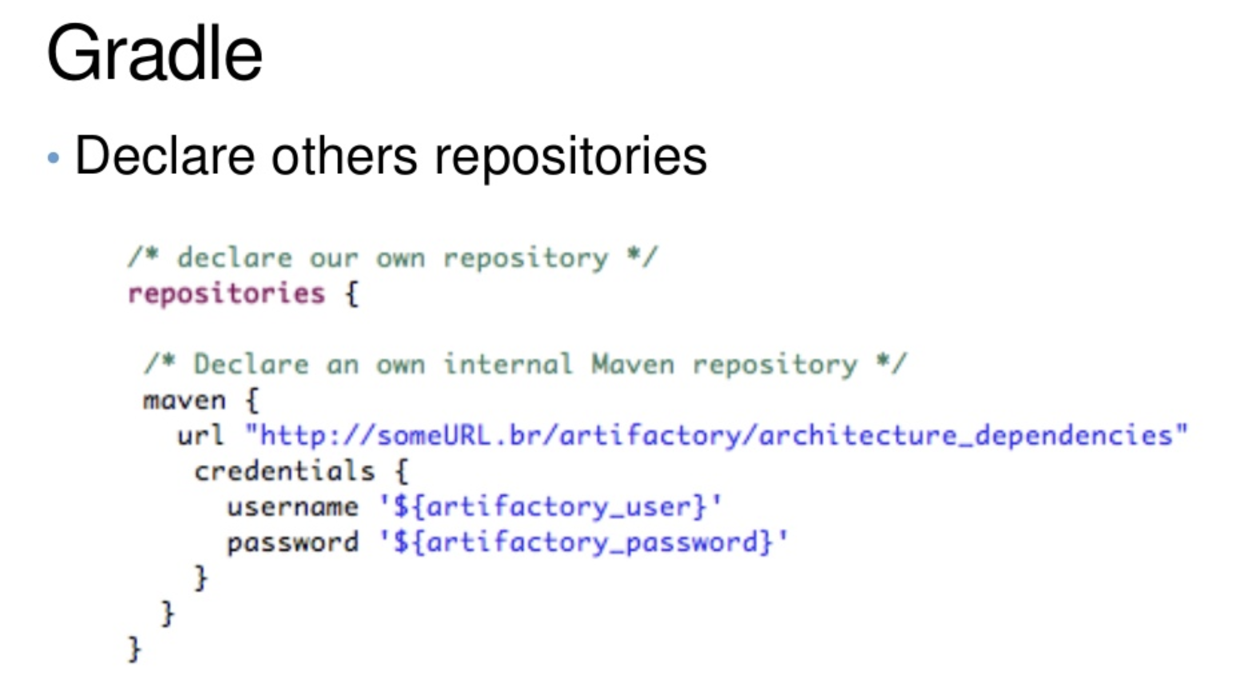

Slide 15
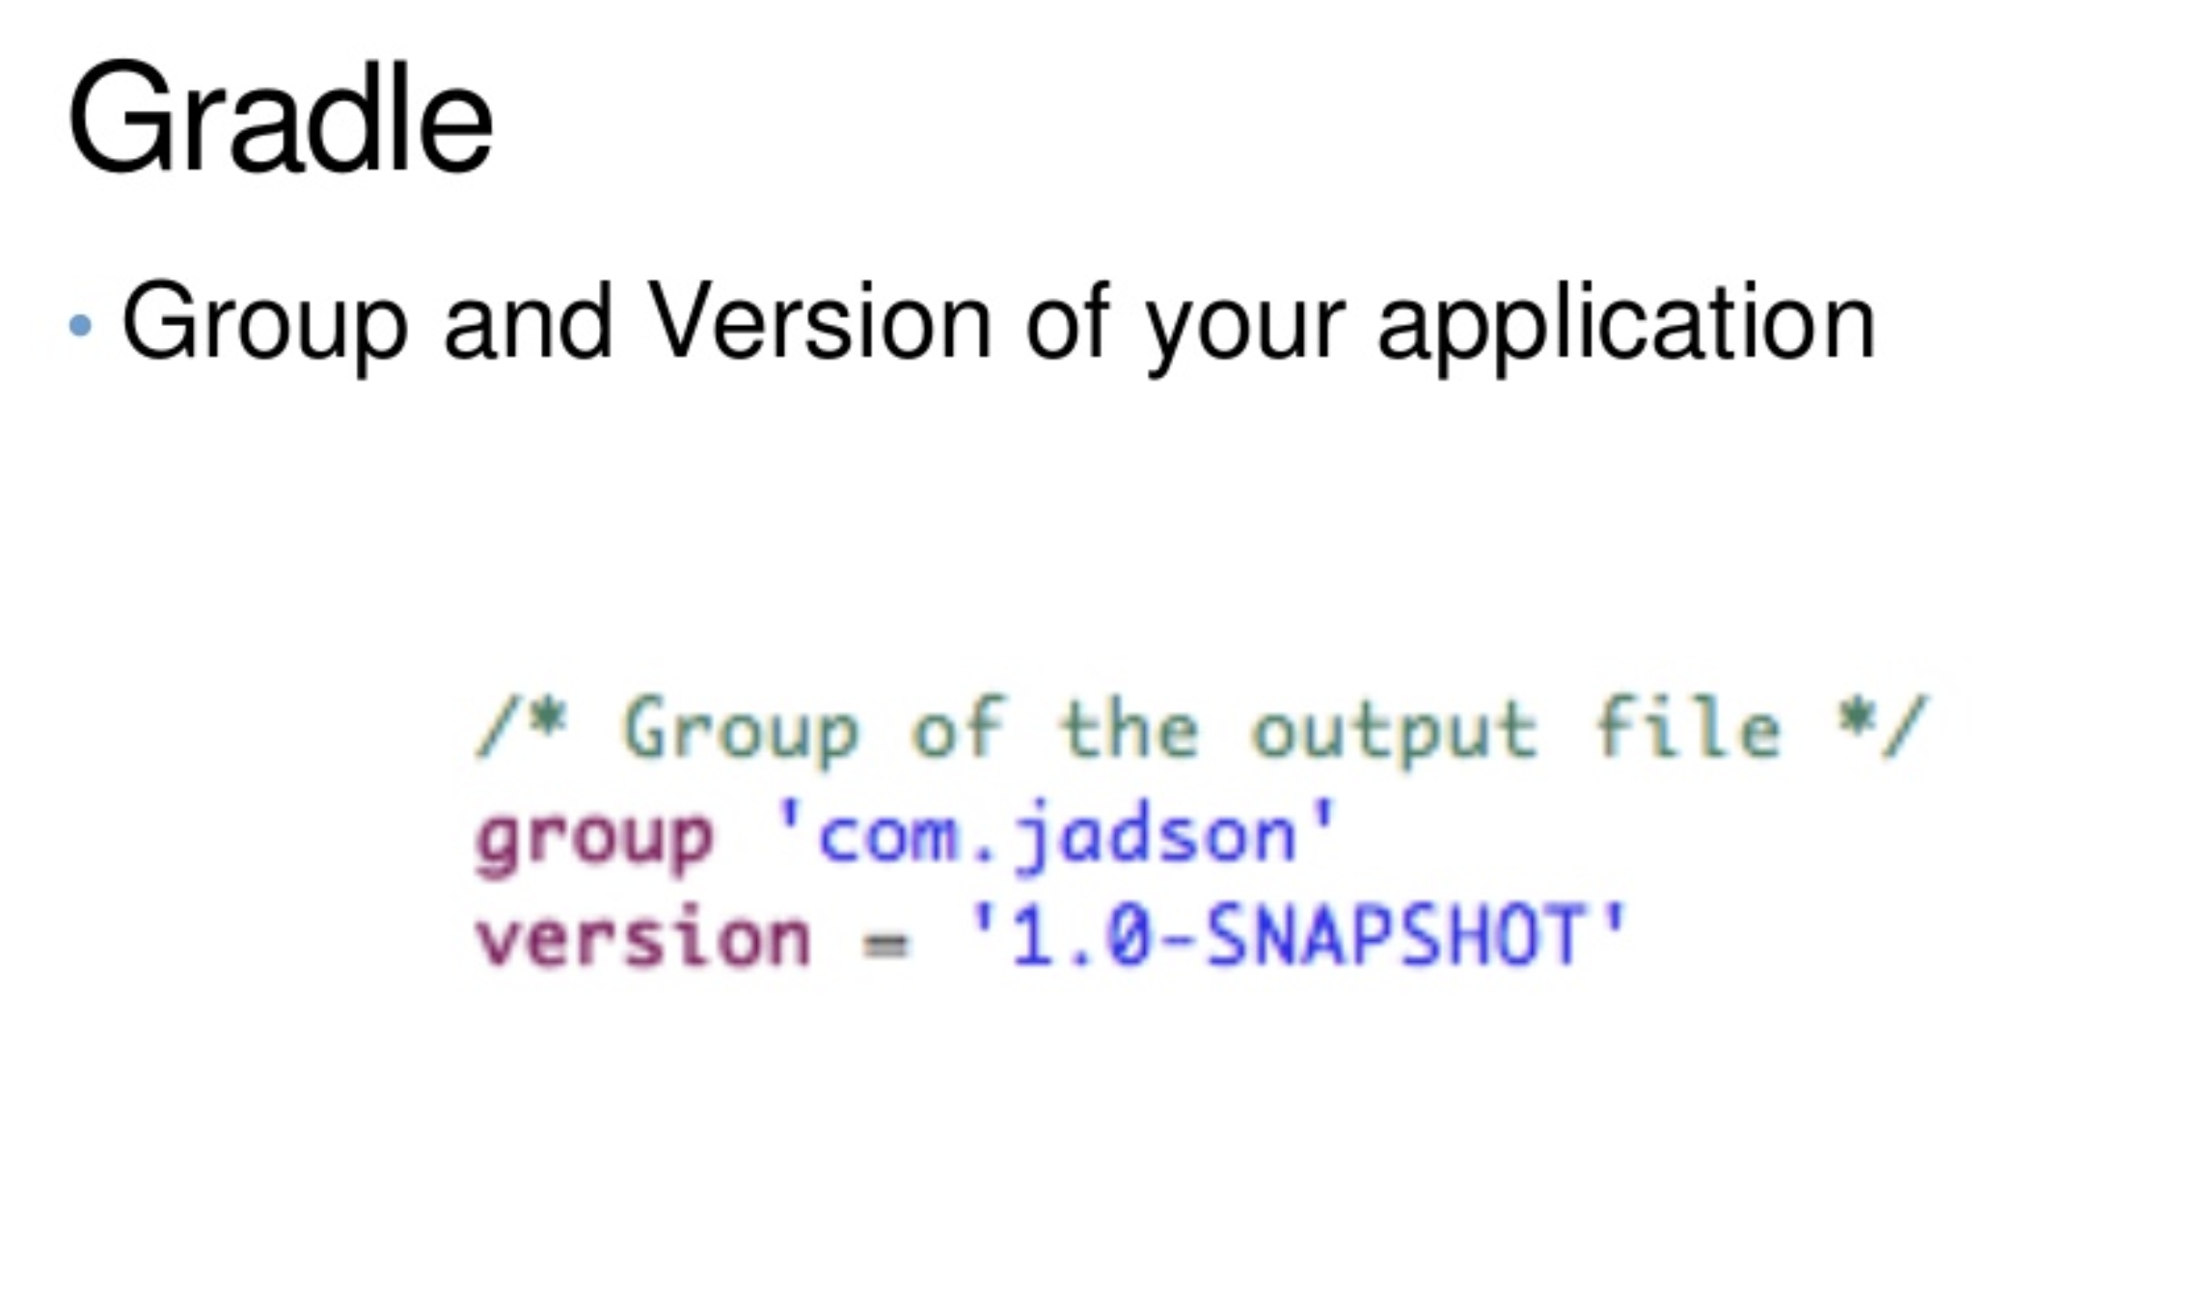

Slide 16
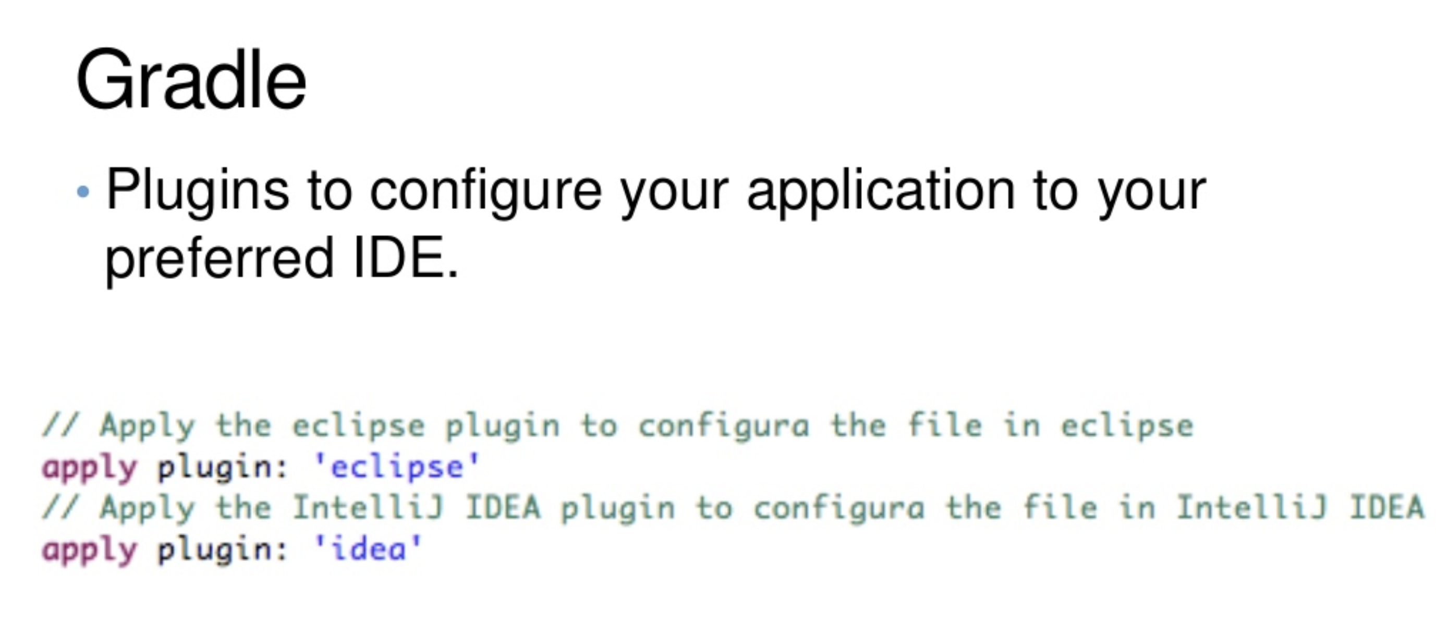

Slide 17
Gradle
Support for automated junit test execution
Ready to use plugins for code coverage, Sonar and checkstyle
Supports multi-project builds
Support composite builds.
Provides gradle wrapper - script that allows you to run a Gradle build even if you don't have Gradle installed.

Slide 18
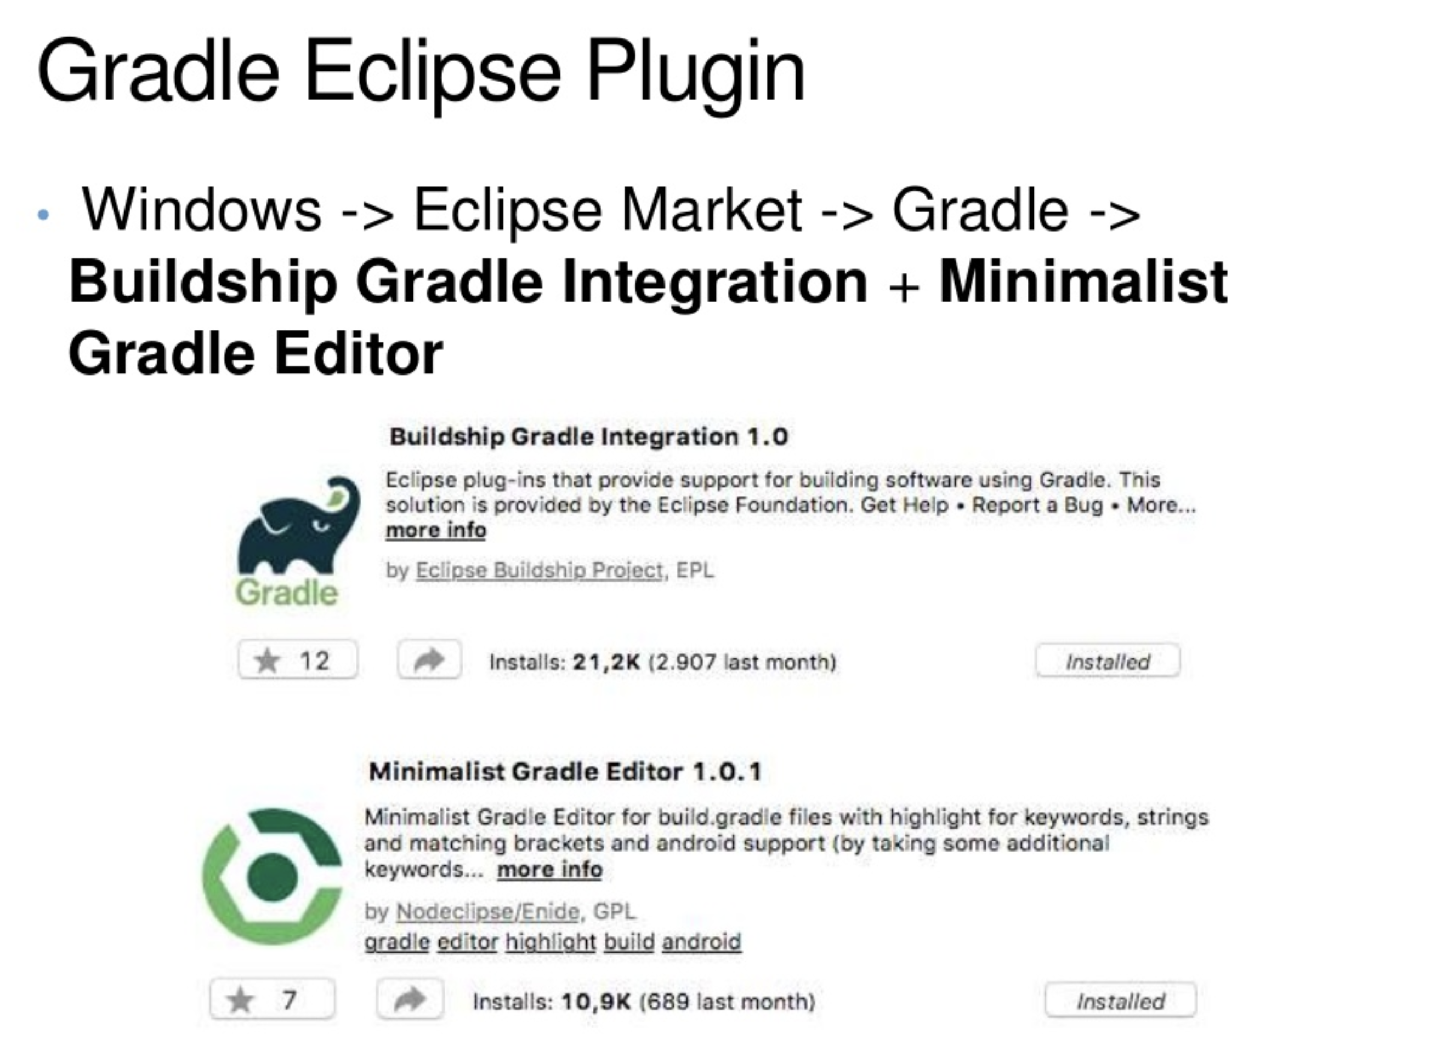

Slide 19
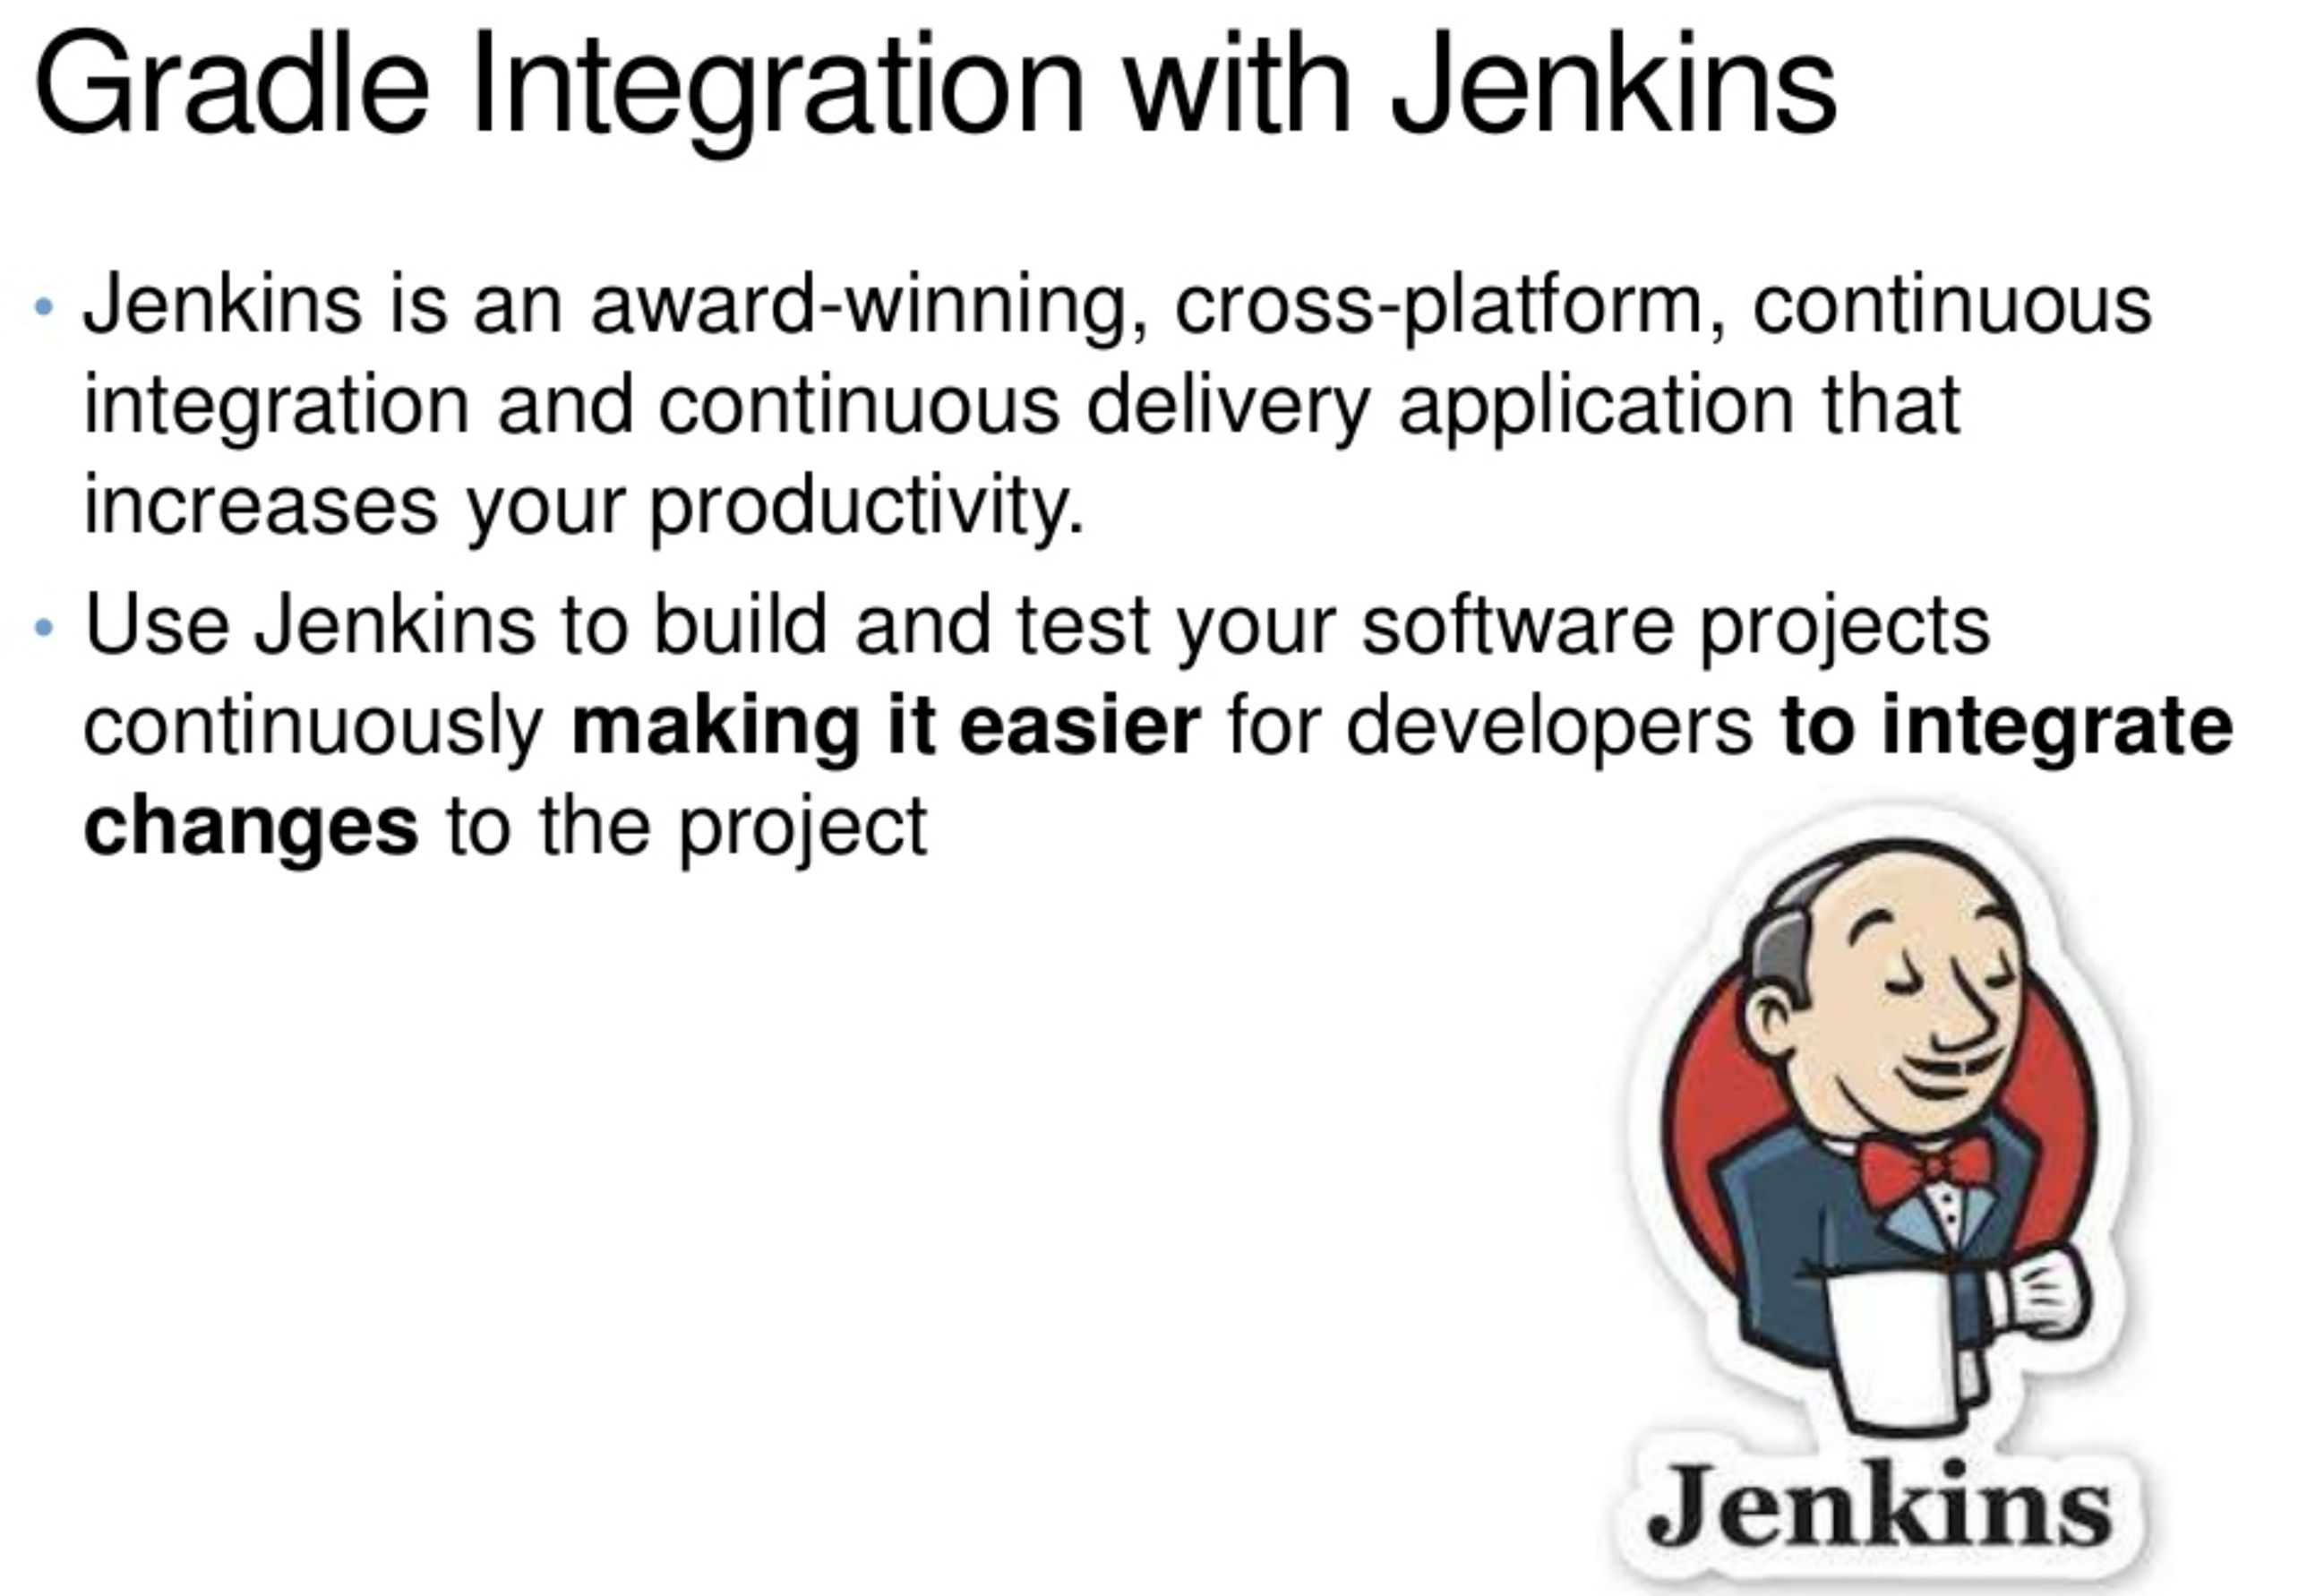

Slide 20


